Slide 1


Toward Cache-Friendly
Hardware Accelerators
Yakun Sophia Shao, Sam Xi,
Viji Srinivasan, Gu-Yeon Wei, David Brooks

Slide 2
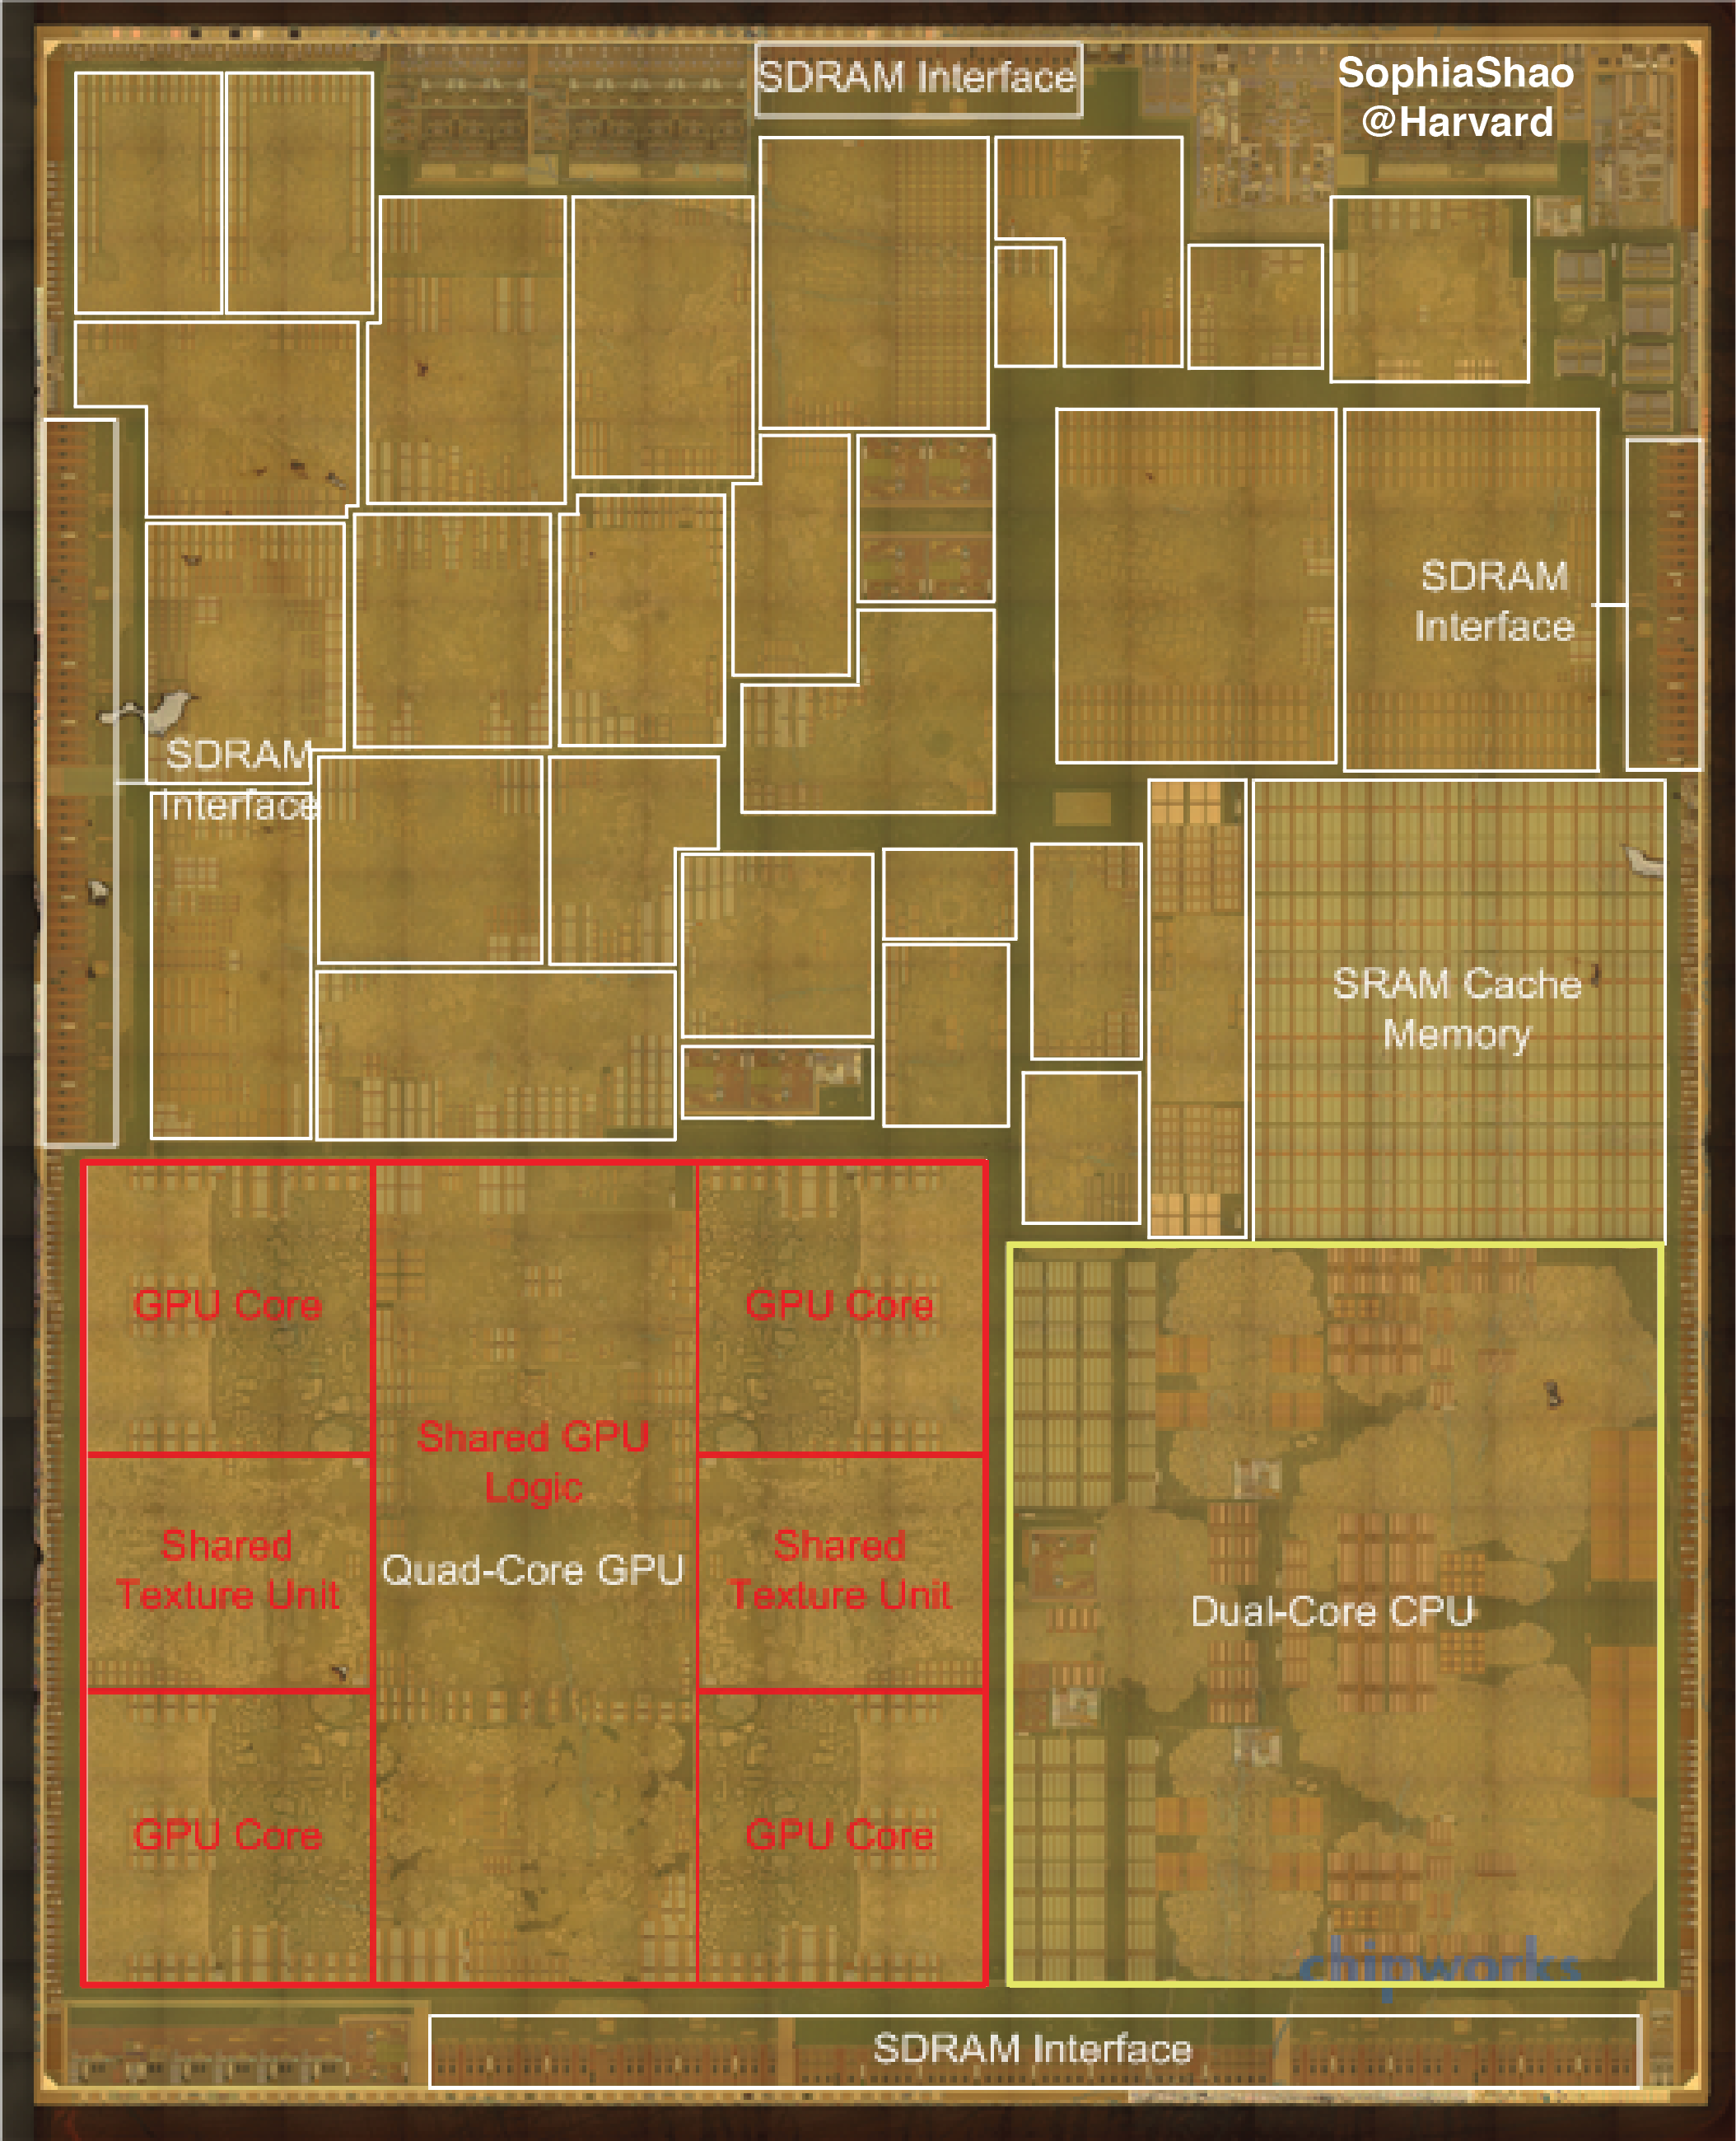
More accelerators.
Out-of-Core
Accelerators
Maltiel Consulting
estimates
Shao (Harvard)
estimates
[Die photo from Chipworks]
[Accelerators annotated by
Sophia Shao @ Harvard]
Notes:
www.anandtech.com/show/8562/chipworks-a8
http://www.maltiel-consulting.com/Next-Apple-iPhone-iPad-A-Processor.html

Slide 3
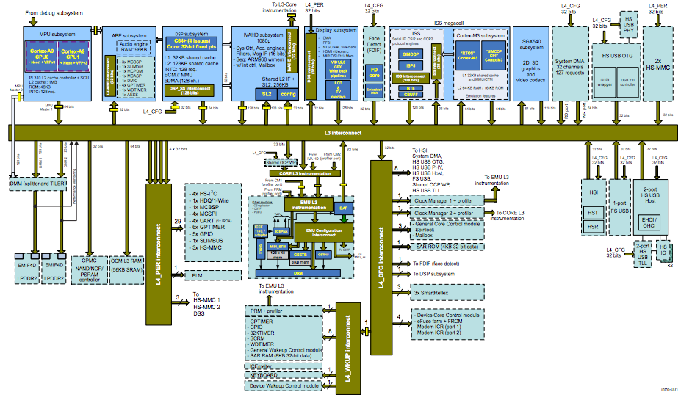
Today’s SoC
OMAP 4 SoC

Slide 4
Today’s SoC
ARM Cores
Audio
DSP
Video
DSP
Face
Imaging
GPU
USB
SD
System Bus
USB
OMAP 4 SoC

Slide 5
Today’s SoC
ARM Cores
Audio
DSP
Video
DSP
Face
Imaging
GPU
DMA
USB
SD
SPM
SPM
SPM
SPM
SPM
SPM
System Bus
USB
DMA
SPM
OMAP 4 SoC

Slide 6
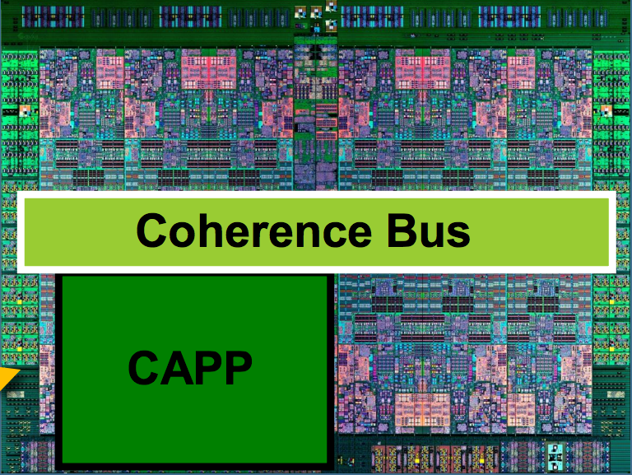
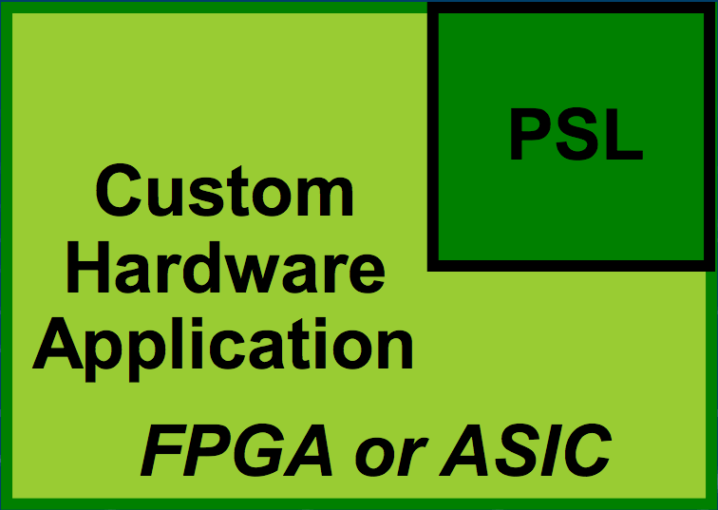
Cache-Friendly Accelerator Interface
Coherent Accelerator Processor Interface
  Virtual Addressing & Data Caching
  Easier, Natural Programming Model
Power 8
PCIe Bus

Slide 7
It’s the beginning, not the end.

Slide 8
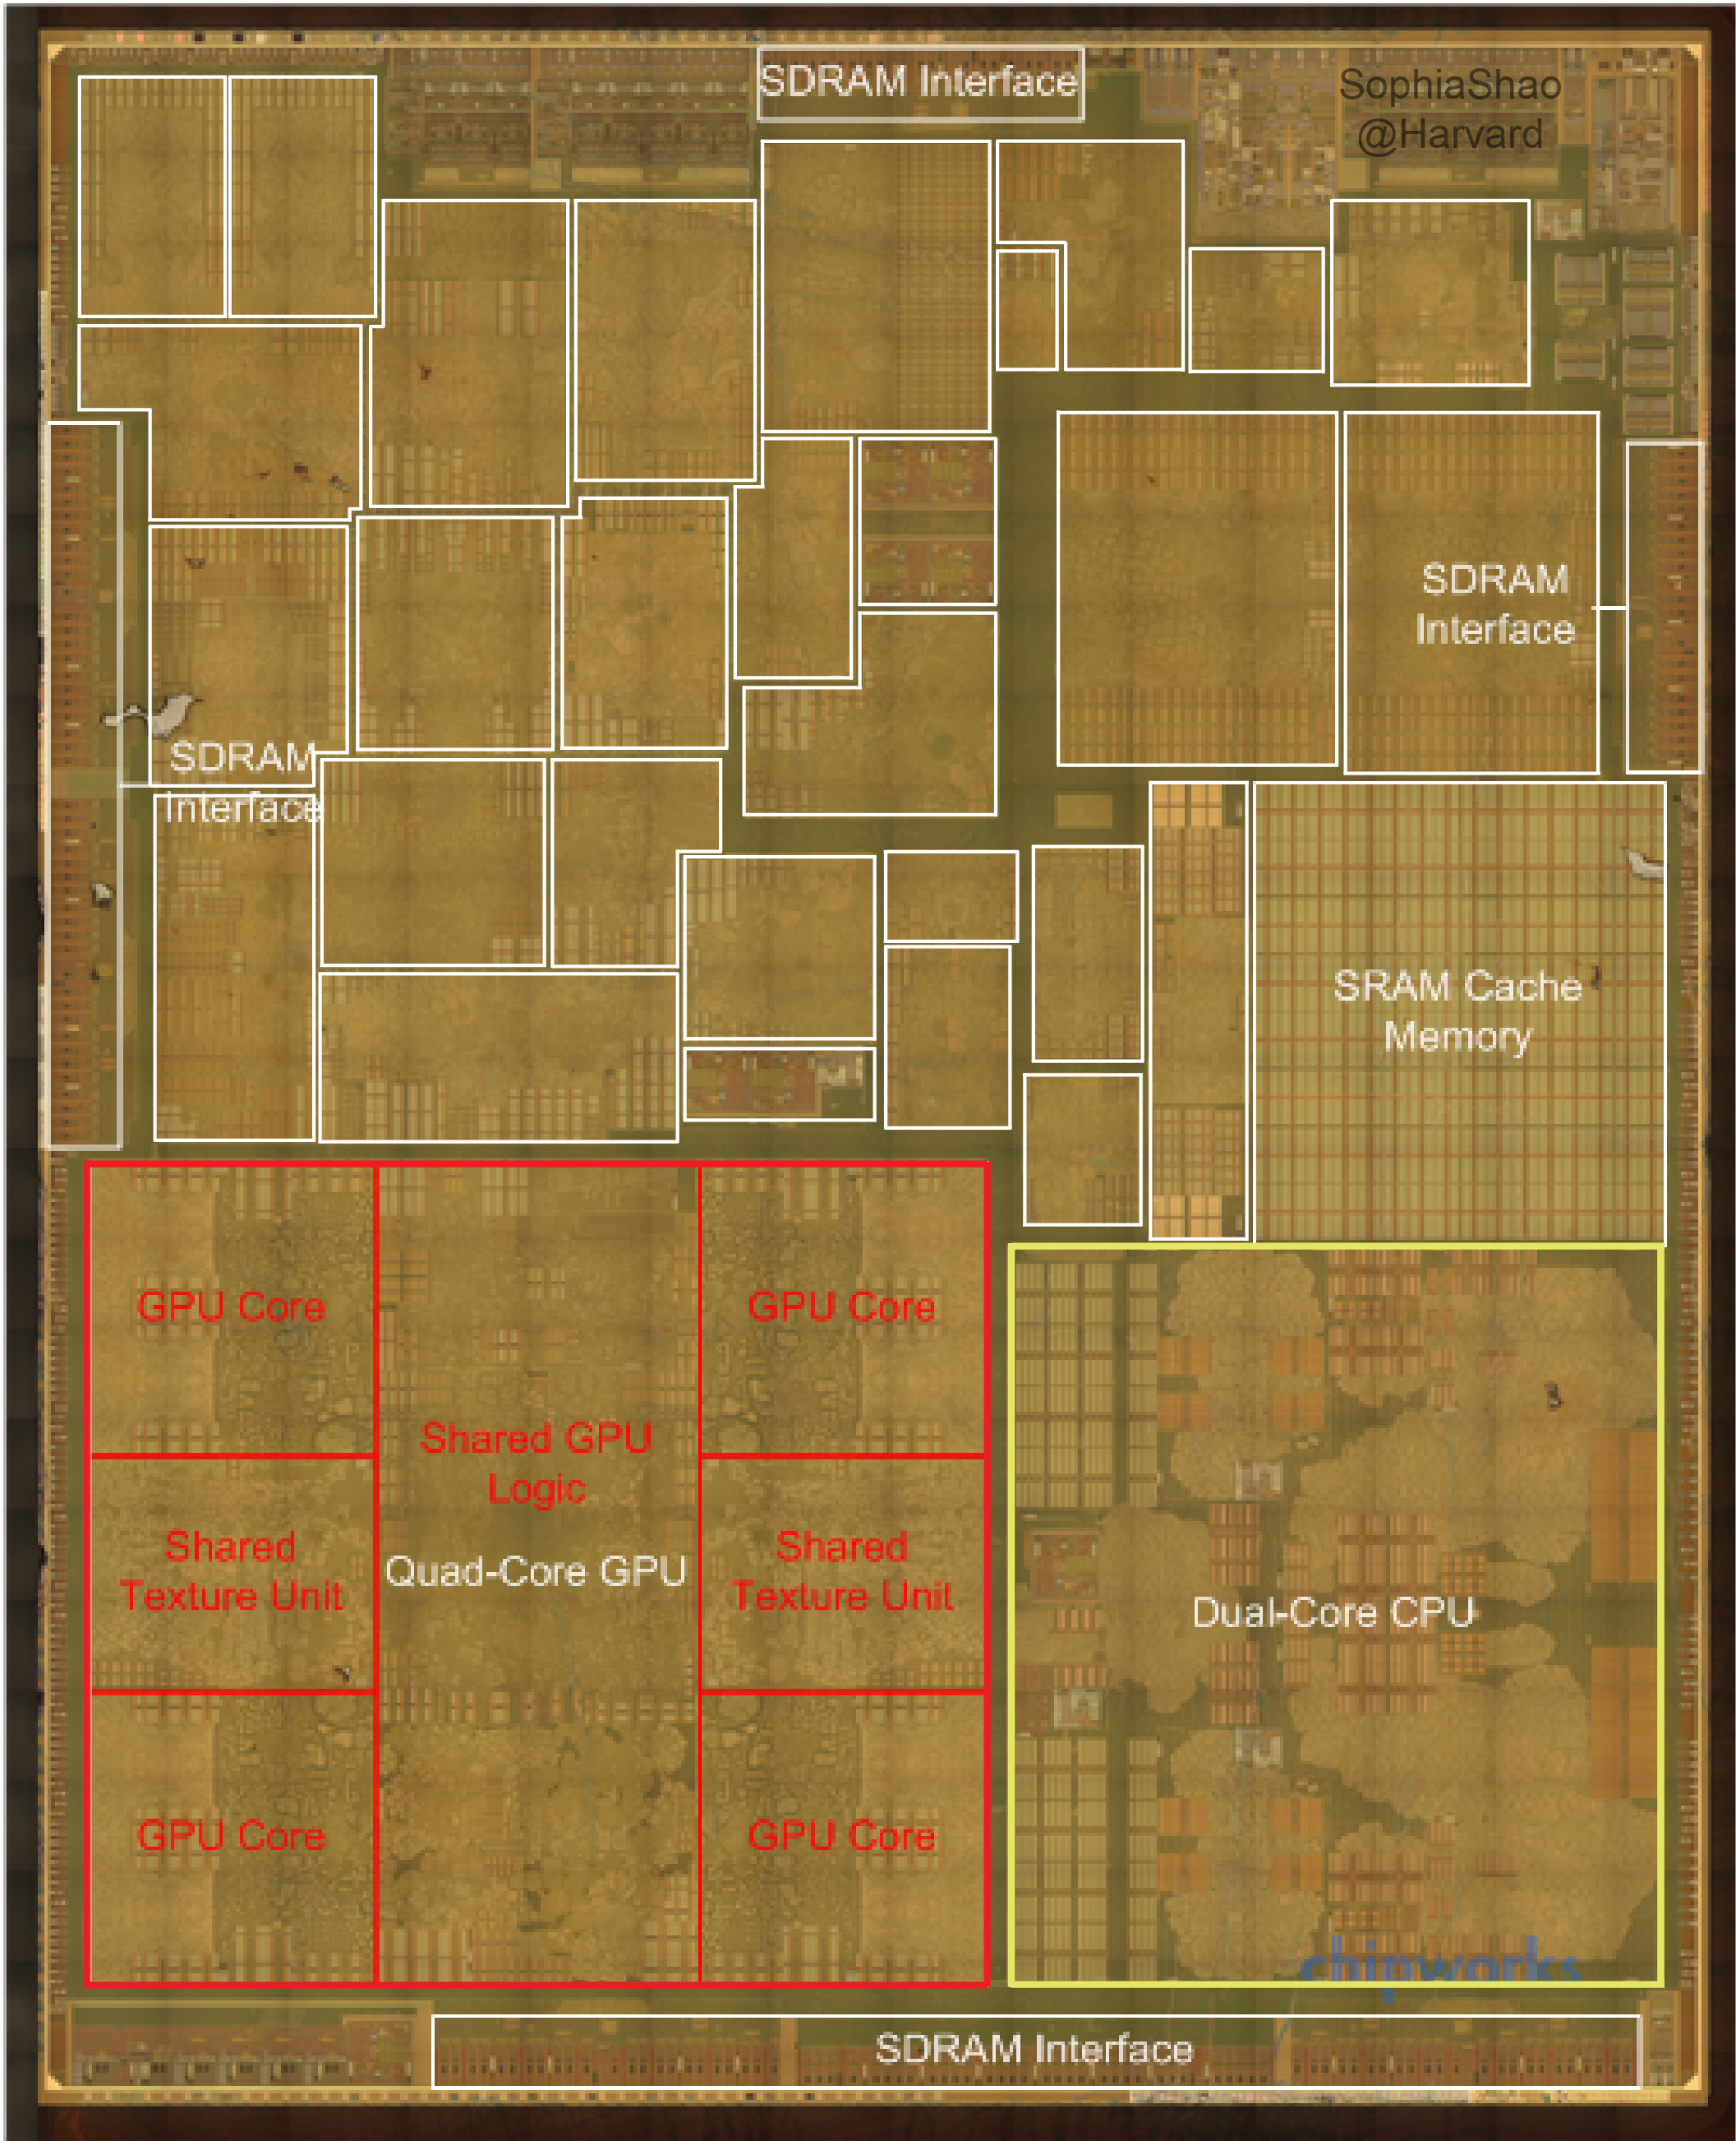
It’s the beginning, not the end.

Slide 9
Not one size fits all.
Different applications have different memory requirements.
Need to customize their memory designs.

Slide 10

Infrastructure Building
GPU
gem5’s DRAM Model
GPGPU-Sim
Big
Cores
gem5’s CPU Model
Small Cores
gem5’s CPU
Memory
Interface
Shared Resources
gem5’s Cache Model w/ Cacti
Accelerators

Slide 11

Aladdin: A pre-RTL, Power-Performance Accelerator Simulator
Shared Memory/Interconnect
Models
Unmodified
C-Code
Aladdin
Power/Area
Accelerator
Specific
Datapath
Private L1/
Scratchpad
Accelerator Design
Parameters
(e.g., # FU, mem. BW)
Performance
“Accelerator Simulator”
Design Accelerator-Rich SoC
Fabrics and Memory Systems
Programmability
[ISCA’2014]
  http://vlsiarch.eecs.harvard.edu/accelerators

Slide 12
Cache Customization
TLB Designs:
  TLB can be expensive.
    Performance: TLB miss.
    Resource/Power: Hardware TLB design.
  But accelerator’s TLB accesses are very likely to be regular.

Slide 13
Accelerator TLB Miss Behavior

Slide 14
Accelerator TLB Miss Behavior

Slide 15
Cache Customization
TLB Designs:
  TLB can be expensive.
    Performance: TLB miss.
    Resource/Power: Hardware TLB design.
  But accelerator’s TLB accesses are very likely to be regular.
Cache Prefetcher Designs:

Slide 16
Inefficient Bulk Data Transfer
DMA is very efficient in getting data.
Cache fetches data at cache line granularity.
Cache prefetcher customization.
Benchmark: kmp

Slide 17
Workloads have different memory behaviors.
Benchmark: md-knn

Slide 18
Toward Cache-Friendly Hardware Accelerators
With more accelerators on the SoCs, programming them will become challenging.
Shared address space and caching make programming accelerators easier.
Leveraging the application-specific nature of accelerators can reduce the overhead of cache.

